Slide 1

Tittle slide:- Tittle: cyber crime prediction subtitle: detailed Project overview your name: Nitesh Kumar , Jitu Kumar, Suleman Khan , Kushal Kumar Date: 05/09/2024

Slide 2
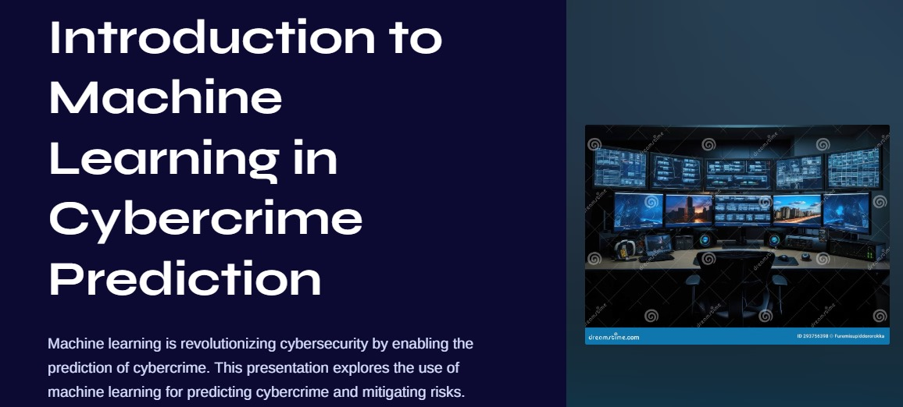

Slide 3
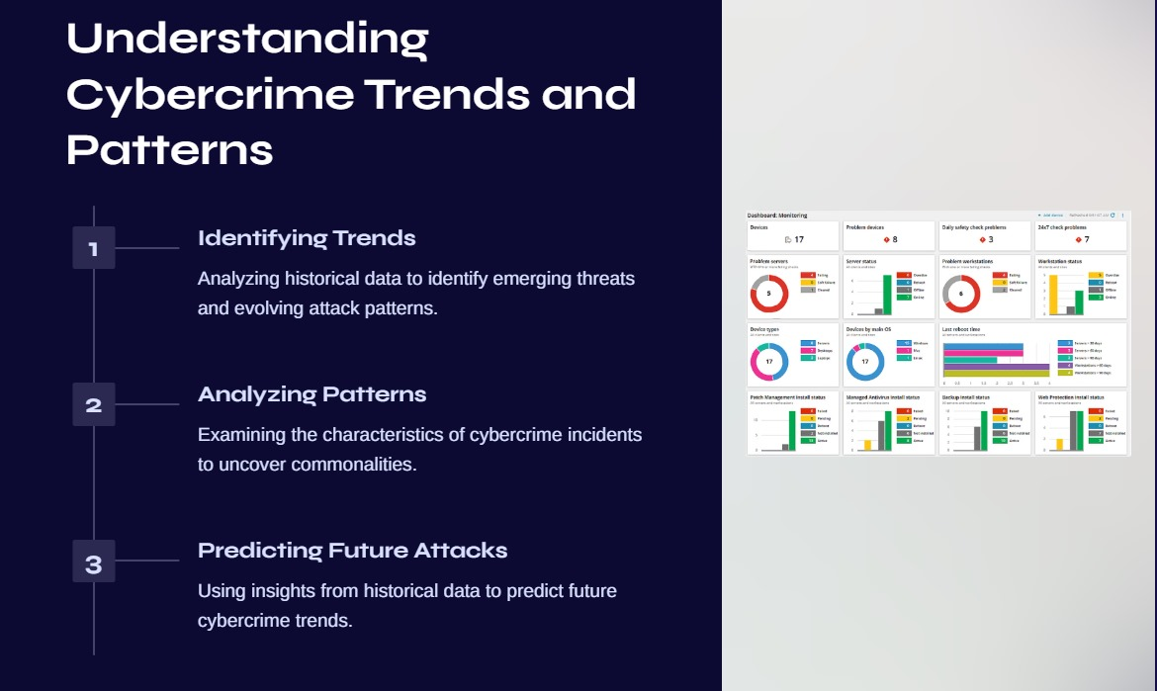

Slide 4
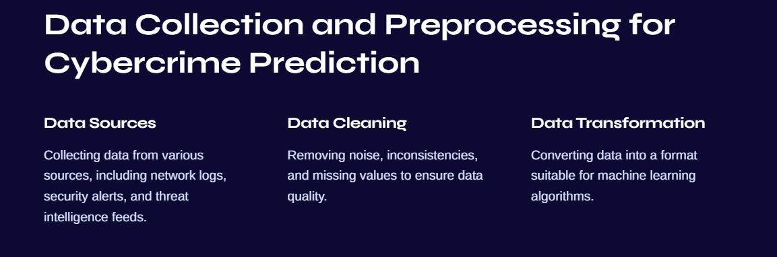

Slide 5
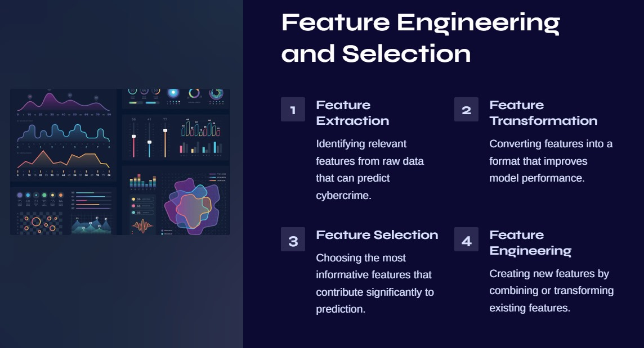

Slide 6
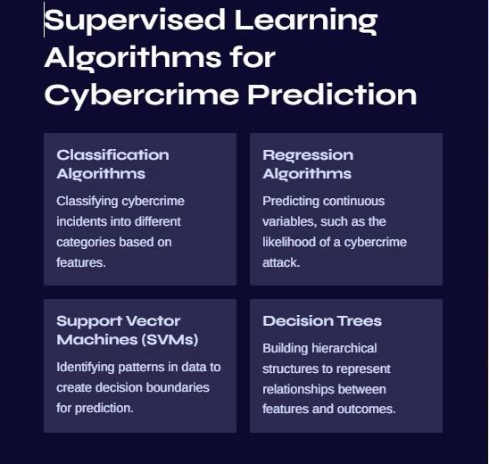

Slide 7
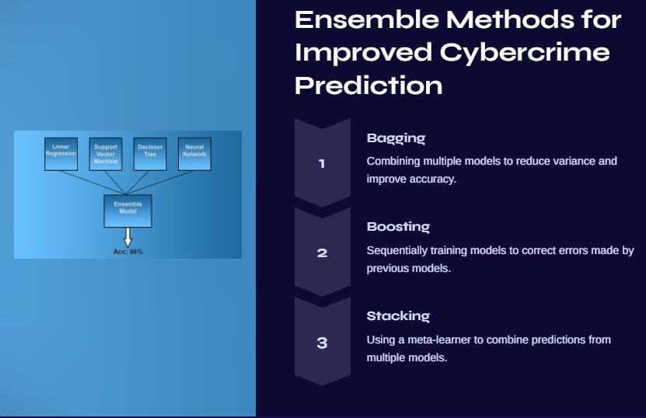

Slide 8
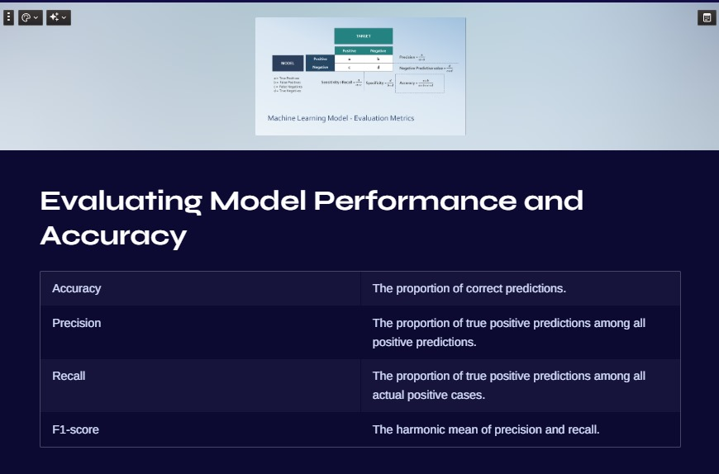

Slide 9
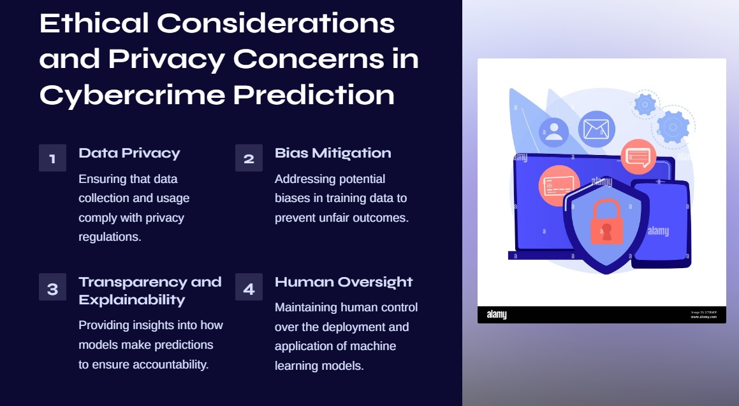

Slide 10


